Slide 1
KML Consultants presents
and
Clubhouse

Slide 2
A bit about me….
I do 1-on-1 LinkedIn training and I now moderate several Clubhouse rooms. I’m a Career Coach for the New Start Career Network at Rutgers University through which I help 45+ older job seekers develop their LinkedIn presence and I started facilitating a weekly LinkedIn Lunch ‘n’ Learn in June.
Today I’ll introduce you to a new app (Clubhouse) which you can leverage as part of your networking strategy when it’s available to you (now only available on Apple devices)
I’ve helping to test functionality to combine LinkedIn and Clubhouse events together – hope to show how our first test went in a bit.
Both should be used in complimentary ways – building relationships and as a marketing tool with other platforms.

Slide 3
You need the right tools
Your Networking toolkit should include:
Using LinkedIn and other social media
Creating a job search team
Attending networking events
Researching companies in your industry
Following up on leads
Now: Clubhouse

Slide 4
Presentation
Part 1 – LinkedIn review
Part 2 – Clubhouse
Part 3 - Putting it all together
There’ll be breaks for Q/A along the way

Slide 5
L LinkedIn Basic Needs
Picture – make sure it looks good on mobile and has sufficient background lighting
Headline (keyword-driven)
About section – needs to be easy to read, compelling and searchable
Jobs
Skills (need at least 3)

Slide 6
L LinkedIn Nice-to-haves
Background image – to further market yourself
Using Featured section
Adding documents or attachments within jobs
A recent recommendation
Write recommendations for others too

Slide 7
You know exactly who I am

Slide 8
Get their attention
Only the 1st 3 lines of your About section will be visible to anyone looking at your profile so make sure it stands out. Also, include your email address in the about section and stuff it with keywords

Slide 9
This is all searchable
Each specialty and skill is searchable. Make it easy to read.

Slide 10
Here’s an example
By boldfacing and capitalizing you can emphasize parts of your profile, or a post. Try it out and see if it makes a difference

Slide 11
Here’s how
There are many tools that can reformat plain text to boldface, etc. to make it look better
https://www.Lingojam.com is the one pictured at left

Slide 12
Skills and Recommendations
Skills should be based on how you want to be ‘found’ and how you want to be searched by. Make sure your top 3 Skills are the ones you want shown. All your skills can also be moved as needed

Slide 13
Linkedin 2021 tips
Your About section needs to be written to reflect how your 𝐩𝐚𝐬𝐭 experience will support your 𝐟𝐮𝐭𝐮𝐫𝐞 employer
Same with your title/heading
Don’t ASSUME – if you’re looking for work, say that in the About section and elsewhere!
Learning not only 𝐡𝐨𝐰 to engage here, but 𝐰𝐡𝐲 it's so important to do that.
Try a video

Slide 14
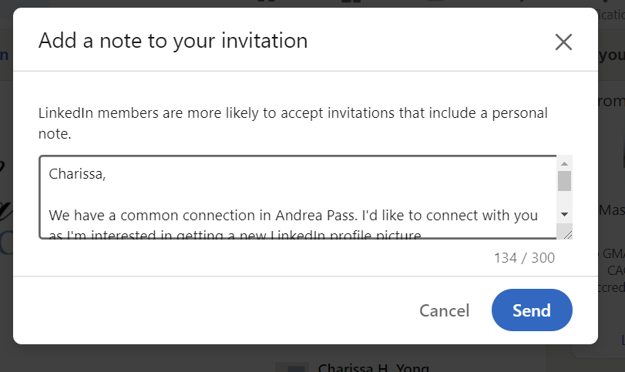
Personalize usually!
Select Add a note
Personalize the reason you want to connect, mentioning something from their profile or a frame of reference. Never be salesy!!!

Slide 15
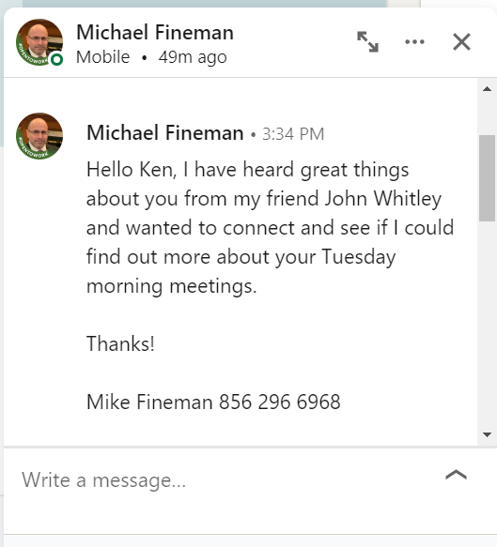
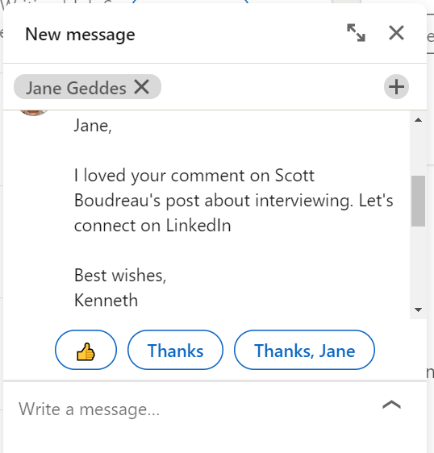
Good connections
Each of these refers to a specific event or reason to connect. Look at their profile and find something there that interests you about them.

Slide 16
Some bad requests
No mention of my name
Hey Patrick, no!
Hi (fill in)…I noticed you’re a (fill in) at the company (fill in)

Slide 17
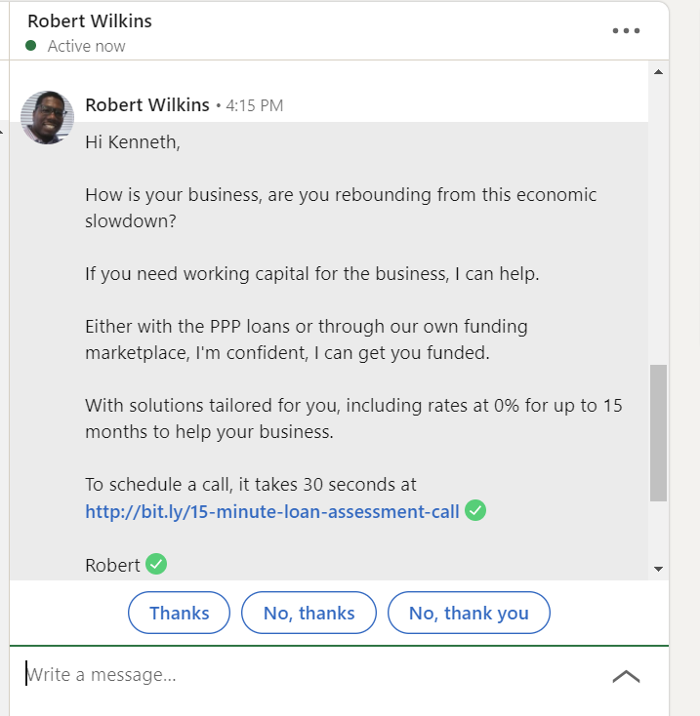
Or even worse

Slide 18
What can you do?
Depending on how you feel, you can Unfollow them, remove them as a connection or Report/Block them.

Slide 19
Recent changes - good
Launch of even-more newsletters
10 second micro-elevator pitch
Multiple types of status updates
Ability to live stream events on your personal or company page
Clubhouse integration – will share more soon

Slide 20
Recent changes – why?
Unable to see 90-day views of your profile without Premium
Same w/ Interview videos (Premium only)
Over-reaching attempt to combat automation – LinkedIn jail and SWAM are alive and well

Slide 21
Market yourself!
LinkedIn says you can record your name pronunciation. But use it as a micro-elevator pitch!

Slide 22
Check your profile
Under Name Pronunciation, you’ll see the option to do that. If you select it, you’ll be prompted to record a 10 second message which you can then review before approving

Slide 23
This is how it will look
On desktop same process -click on the ‘microphone’ to hear

Slide 24
Phrases to avoid
Genuine
Authentic
Problem solver
Extraordinary
Virtual ‘x’
Zoom Fatigue
Ninja
Unprecedented
Unmatched
Customer Journey
Thought Leadership
Brainstorm
Muscle memory
Expert

Slide 25
Networking events
Find them on
https://www.meetup.com
https://www.landingexpert.com
https://lunchclub.ai/
https://www.1000hires.com/
Clubhouse

Slide 26
Questions?

Slide 27
Clubhouse is….
Clubhouse is an invite-only voice-based social media app – iPhone or Ipad only now
You can also signup and be on a waiting list - those on the platform will be notified you want to join (called the ‘back door’)
Users enter different rooms to listen or participate in conversations.
You’re able to see room participants by their profiles. The person who creates the room is the room moderator.

Slide 28
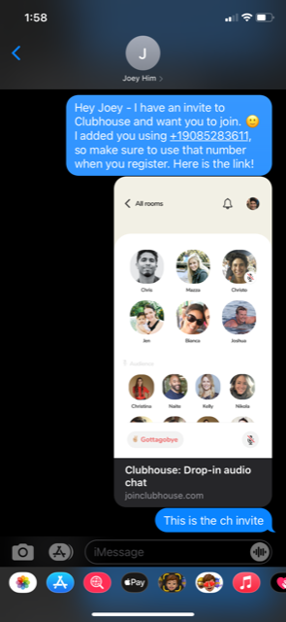
How Clubhouse works
https://www.clubhouseguide.com/ is where you can find out about being added to a waitlist, or you get an invite from someone there as long as you’re both contacts.
Here’s an example of how this works

Slide 29
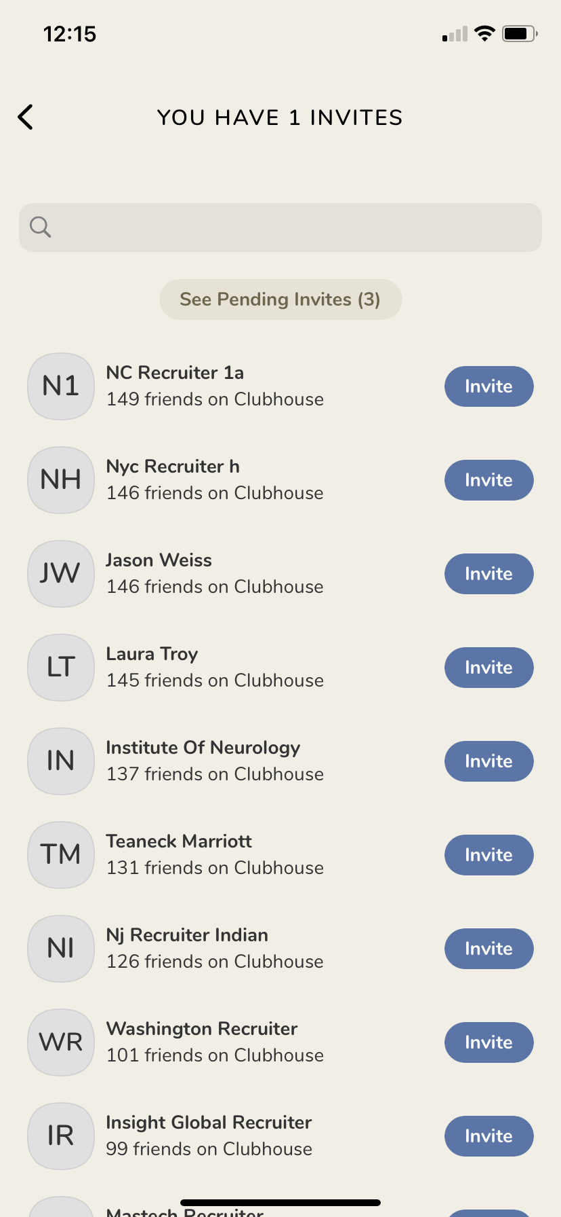
Your Clubhouse profile
You create a profile (far left). You follow people and they follow you – much like Twitter. (Near left) is how people can be invited. I can search for someone as the default is the most common CH members is listed on top

Slide 30
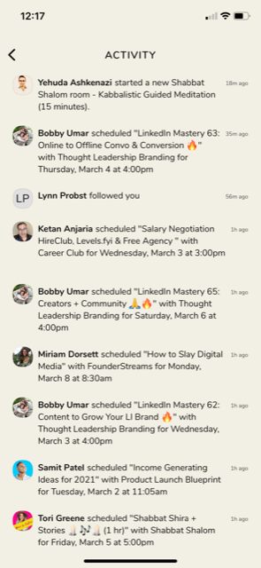
Ac Activity feed/Home page
Clubhouse has an Activity feed based on your followers (left) – think LinkedIn notifications – you can turn notifications off and be notified by text
At right is the basic Clubhouse home page where you can search for people or clubs of interest in different categories

Slide 31
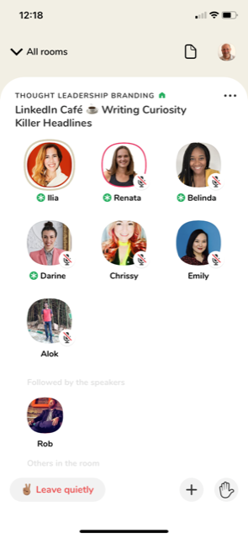
Clubhouse room overview
There are different rooms and clubs going on based on interest. You can search within your Activity feed. When you join a room, you’ll see everyone attending
Within a room, you can raise your hand, add someone to the room or leave the room quietly

Slide 32
More Clubhouse basics
On the left, select anyone in the room and see their Clubhouse profile which includes links to their LinkedIn profile, Twitter and Instagram handles. When you’re muted, you’ll see the microphone w/line through it. The brown circle around someone means they’re speaking
On the right is how you’d be invited to the room (+)

Slide 33
Clubhouse and LinkedIn
We’ve been creating a LinkedIn event with a link to Clubhouse. Even if you’re not on Clubhouse, connect with attendees

Slide 34
Why join Clubhouse?
Access to topics and speakers
Relationship building
Knowing how to use it will make you an SME (Subject Matter Expert)
It’ll be open to anyone
There are rooms and clubs where recruiters and job seekers make real time connections

Slide 35
Jargon
CH is Clubhouse and MODs are moderators of rooms
Newbies have party hats
Room moderators set their own room rules along basic guidelines
RTR (Reset the room)
PTR (Pull to refresh)
Clubhouse best practices

Slide 36
Best practices
Anyone can ask a question by coming to the Clubhouse 'stage' (the area above 'Followed by the Speakers)
The green circle shows the Room moderators
If you select the 'hand' icon, you'll be brought to the stage – not all rooms have this option
If you moderate a room, you can invite others to the stage and return them to the audience

Slide 37
Use LinkedIn and now Clubhouse
To….
Connecting with like-minded individuals and non like-minded individuals
Commenting on other’s posts (LinkedIn)
Mention you met on Clubhouse and in which room
Schedule follow-up meetings after connecting
Asking for advice and help – a very under-utilized tool and great on Clubhouse.

Slide 38
This is a taste of CH
https://www.linkedin.com/posts/virginiafrancoresumewriter_jobsearch-linkedin-clubhouse-activity-6774383824064270336-vji3 - Great article to read
https://youtu.be/_udxp39Tk68 -- ---------Vidh
https://www.linkedin.com/video/live/urn:li:ugcPost:6773988299720679424/ - Our LinkedIn Live/Clubhouse test

Slide 39
Questions?

Slide 40
New considerations
Post longevity remains more important than 1st hour of post views and comments
Ensure most of your posts will be relevant up to a week after you create them
Minimize tagging with ‘@’
3 to 9 ‘#’ hashtags – we’re putting together a directory of the top ones to use
These changes are mainly due to PODs and ‘bots’

Slide 41
Newsletters
Scroll down your ‘My Network’ feed and you’ll find suggested newsletters you can subscribe to

Slide 42
View your Dashboard
Search appearances is a great way to see if you’re finding the right people.

Slide 43
Search by profession

Slide 44
Search by company

Slide 45
Search appearances
This is the keyword functionality that won’t be available unless you have a Premium account

Slide 46
Posting options
You can now add videos when creating a post. You also have 5 different options. This can be as free form as you’d like; put your content (cut/paste of URL) or start a basic post (like a Top 10 tips for…) – Don’t overthink this! ’

Slide 47
Offer help
By selecting this you may be contacting by others who need specific help – By checking these off, they’ll be added under your LinkedIn title

Slide 48
Find an expert
Categories are: Accounting, Coaching & Mentoring, Design, Marketing or Other – then sub-categories are available

Slide 49
Create a poll
You have 140 characters for a question with up to 4 multiple choice selections along with a poll duration. I recommend using the default ‘1 week’ – the poll length can be from a day to 2 weeks.
Note: You can’t update the poll once posted (including fixing typos)

Slide 50
My latest one

Slide 51
More robust searching
You now have additional search criteria – ‘Events’ is a great hidden networking tool. You can search for events that are relevant to you. This is also part of the Events functionality rollout – where anyone can create an event now .

Slide 52
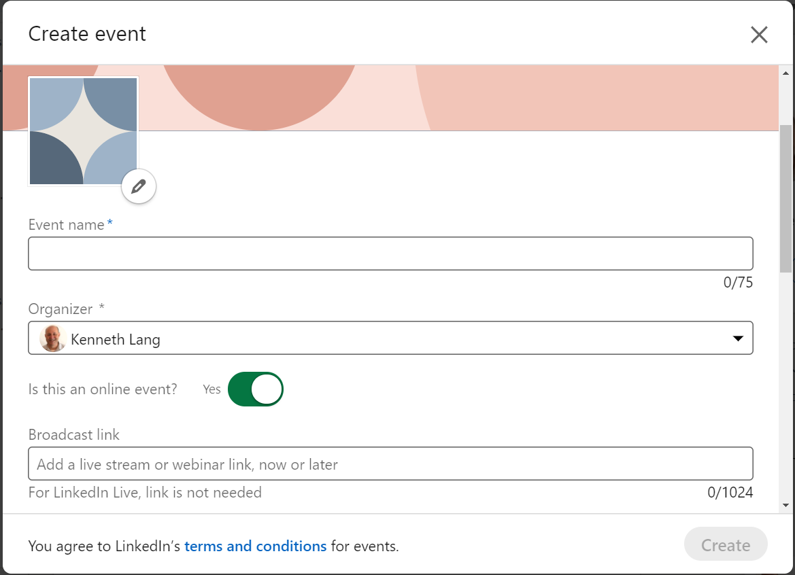
Creating an event
Select ‘+’ from Events on your home page to create an event or see events you’re attending. Events are located under your Groups.

Slide 53
This is how it’ll look

Slide 54
Another change
LinkedIn is rolling out the ability to ‘flag’ profiles of those who have passed on. To [Memorialize] or [Close] you’ll need to submit the following information with your request: Member's full name, LinkedIn profile link/URL, Relationship, Member's email, Date of passing, Death certificate, & Legal documents to show you have the authority.

Slide 55
LinkedIn help
Follow this page on LinkedIn to post questions and discuss issues

Slide 56
Follow-up comments
LinkedIn is NOT a substitute for in-person or online networking, but it’s needed now more than ever
Build a network now for follow-ups later
There’s lots of information about LinkedIn and differing opinions about how to use it
Dwell time is a new way that LinkedIn determines how much visibility posts get – not just ‘liking’ a post by engaging on it

Slide 57
TTa Take the plunge
What are you
waiting for????

Slide 58
LinkedIn reminders
You’re more than 20 times likely to be viewed if you have a picture
Your background picture is another way to market yourself and your business
Engaging on LinkedIn will help you get noticed as an SME (Subject Matter Expert)
LinkedIn is Keyword driven

Slide 59
Clubhouse thoughts
While invite only, most of us have invites and get more all the time
There’s lots of great conversation there
Anyone can start their own ‘room’ to talk about whatever they want to
Your profile there can be even more personal if you choose that route

Slide 60
The party continues
I moderate 3 weekly rooms on Clubhouse – Tuesdays at 3 pm (job search), Thursdays at 11 am (Automation with Rachel Simon) and at 5:30 pm (Resume reviews with Virginia Franco and Claire M. Davis)
If you have an Iphone or Ipad, I have several invites to join Clubhouse
We’re represented there by Abby, Ed Han, George Pace, Lynne Williams and Jack Kelly

Slide 61
Thank you!
I appreciate the opportunity to present some of the latest changes to LinkedIn and Clubhouse.
For more information email me at
ken@kmlconsultants.com
Call me at 973-768-2796
Connect with me on LinkedIn- https://www.linkedin.com/in/langk/
Follow me on Clubhouse at @kenlang

