Slide 1
The Five Habits of Highly Effective Job Hunters
The Breakfast Club
November 2023

Slide 2
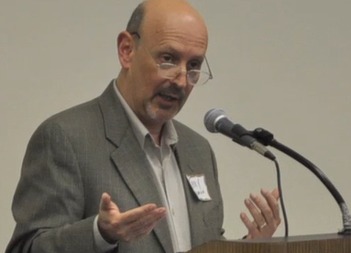
Your Presenter
Terrence H. “Terry” Seamon
Executive Career Transition Consultant with Smart Moves Coaching
Co-Founder of St. Matthias Employment Ministry in Somerset
Find me on LinkedIn and let’s connect

Slide 3
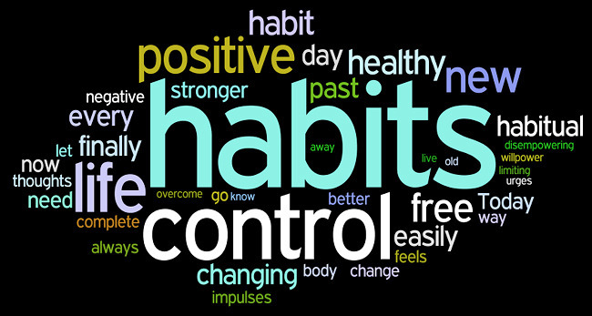
The Five Habits
Get Focus
Spend Time on Priority Activities
Present your Best Self
Leverage Relationships
Be the Solution
This Photo by Unknown Author is licensed under CC BY-SA-NC

Slide 4
Habit 1: Get Focus
The highly effective job hunter is very focused:
The Objective(s) of their search, i.e., what they want to achieve
Target Roles/Companies/Organizations where they would like to land and work
Their Strategy, i.e., how they plan to reach their goal
Their Career plan, i.e., a Vision for the future
This Photo by Unknown Author is licensed under CC BY

Slide 5
Question about Focus
What do you find most challenging about focusing your search?

Slide 6
Habit 2: Spend Time on Priority Activities
The highly effective job hunter spends their time on the most important activities, especially:
Networking, i.e., reaching out to others to form mutually beneficial connections
Learning, i.e., adding to their portfolio of capabilities
Marketing, i.e., finding out where the needs are and putting themselves “out there” to increase their visibility
This Photo by Unknown Author is licensed under CC BY-SA

Slide 7
Question on Priority Activities
What are your top 3 priority activities in your search?

Slide 8
Habit 3: Present Your Best Self
The highly effective job hunter works on presenting their “best self,” especially on:
The Resume (and cover letters, follow-up notes etc)
LinkedIn profile and presence (and other social media)
In Person
This Photo by Unknown Author is licensed under CC BY-ND

Slide 9
Question on Presenting Your Best Self
What is One Thing that really helps you to present your best self?

Slide 10
Habit 4: Leverage Relationships
The highly effective job hunter cultivates relationships:
The people you know
The people they know
The people you want to know

Slide 11
Question on Leveraging Relationships
How do you reach out to people you would like to meet?

Slide 12
Habit 5: Be the Solution
The highly effective job hunter knows the “secret” to getting hired: It’s You. You have value. Know that.
Be the solution.
Believe in yourself.
Be prepared. Be positive
Be open. Be ready to change.
This Photo by Unknown Author is licensed under CC BY-SA

Slide 13
Question on Being the Solution
What helps you to position yourself as the solution to an employer’s needs?

Slide 14
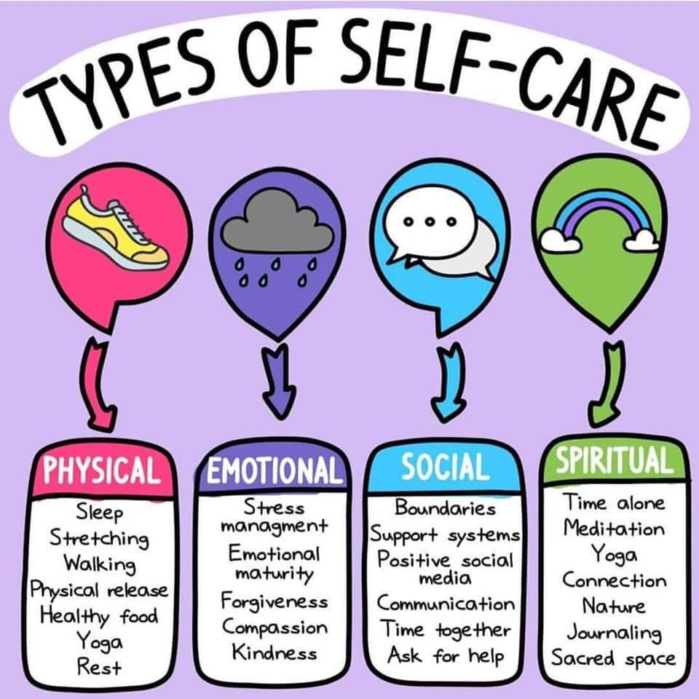
Habit 6: Take Care of You
This Photo by Unknown Author is licensed under CC BY

Slide 15
Question for You
Which habit do you need to work on?
This Photo by Unknown Author is licensed under CC BY-SA-NC

