Slide 1

Sign up early for discounts
Fun social events!!
UPCOMING EVENTS (via Meetup)
• Thu, 18 Sep – Soak Up the Last Days of Summer With Us! (5.30p)
• Fri, 10 Oct – The Spirit of Asbury Park: A Haunted Exploration (6.45p)
• Thu, 30 Oct – 50th Anniversary of The Rocky Horror Picture
Picture Show (6.30p)
Scan to Register!

Slide 2

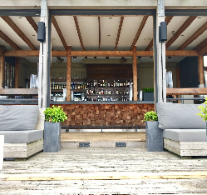


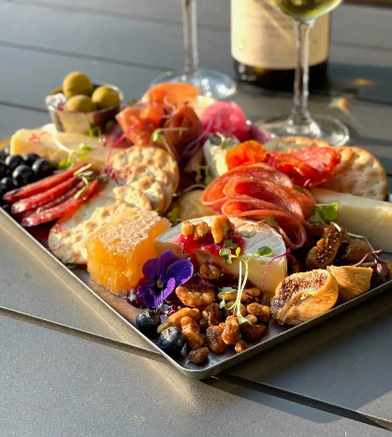
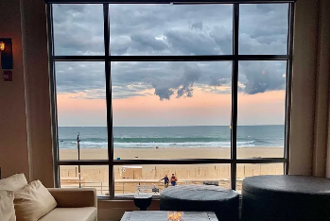
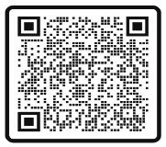
Soak Up the Last Days of Summer With Us!
A beautiful setting to meet and relax.
Thursday,18 September
5.30 to 7.30 PM
Sign up today!
Scan the code to register

Slide 3
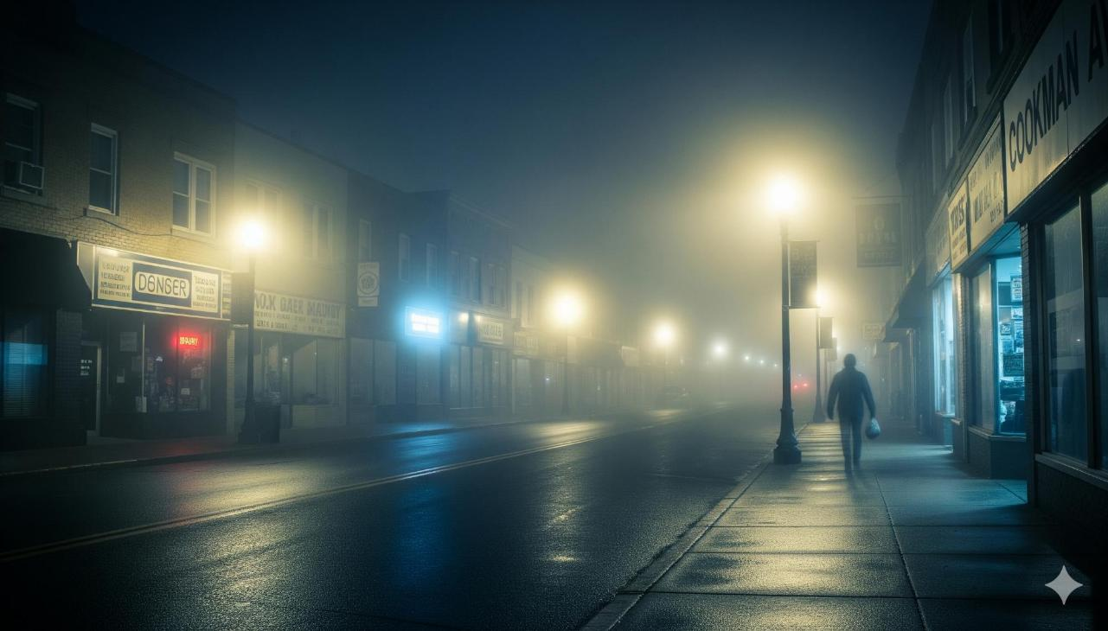

Believe in the magic of the season
The Spirit of Asbury Park:
A Haunted Exploration
Scan the code to Register
Limited space
Get seat now before the price increases
10 Oct
6:45 to 9 pm

Slide 4



50th anniversary
Support Camp; Support Fun
New Brunswick
Thu, 30 Oct

Slide 5
Sign up early for discounts
Fun social events!!
UPCOMING EVENTS (via Meetup)
• Thu, 18 Sep – Soak Up the Last Days of Summer With Us! (5.30p)
• Fri, 10 Oct – The Spirit of Asbury Park: A Haunted Exploration (6.45p)
• Thu, 30 Oct – 50th Anniversary of The Rocky Horror Picture
Picture Show (6.30p)
Scan to Register!

